Slide 1




Ambulatory Safety Nets: Creating High-Reliability Solutions to Prevent Missed and Delayed Diagnoses
Sonali Desai, MD, MPH
April 3, 2019

Slide 2
Reliable systems are needed for abnormal test result follow-up
Alleviation of clinician burnout
Collaboration with existing programs
Interventions with high-impact potential
Leveraging technology
High-risk areas

Slide 3
What are the key ingredients for a safety net?
Patient registries
Workflow redesign
Patient outreach and tracking

Slide 4
Colon Cancer Safety Nets
Patients with prior colonoscopy/ pathology due to return
Rectal bleeding
Iron-deficiency anemia
Identify patients at risk for delayed diagnosis of colon cancer
Leverage Epic Safety Net registries of patients with prior colonoscopy with pathology, iron deficiency anemia or rectal bleeding
Conduct population-based outreach to promote colonoscopy
At-risk for colon cancer

Slide 5
Lung Cancer Safety Net
NLP on radiology reports to identify nodules
Chart review validation for true incidental nodules requiring f/u
Email PCPs with lists and track patient f/u
Nodules from 2016-2017
Nodules in 2018
Deploy a more automated lung nodule communication, scheduling and tracking system in collaboration with Radiology (RADAR)
Primary Care at BWH
ED, Inpatient
Followed at BWH by Specialist
Incidental Lung Nodules

Slide 6
Basics of Building a Safety Net Program

Slide 7
Step 1: Build Patient Registry
Data elements
Coded data
NLP
Registry
Requires effort to ensure clinician proactively enters
Requires effort to extract and validate with chart review

Slide 8
Step 2: Clinical Best Practice Guideline Development
Pri Care
GI
Radiology
Clinical pathways to pilot within practices or departments
How many at-risk patients are identified?
What do external guidelines say?
What is unique to your patient population or org structure and feasible?
Is there local agreement with guidelines?

Slide 9
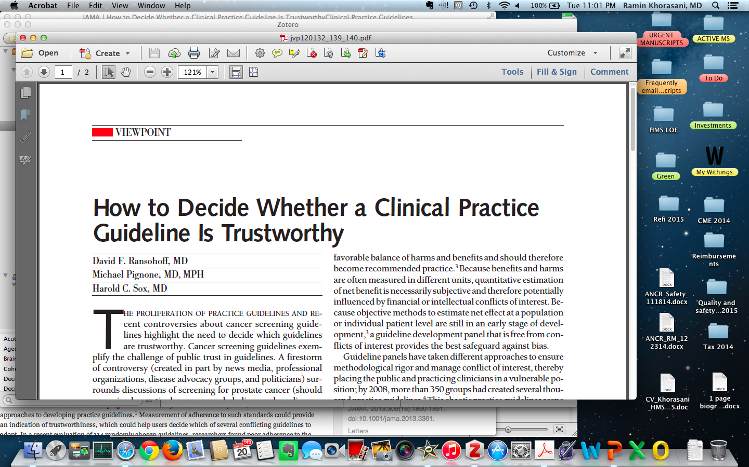
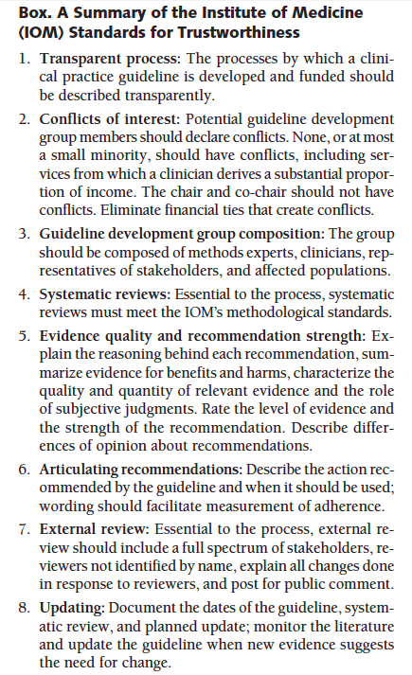

Level of Evidence matters…
expert opinion ≠ valid guideline that clinicians are willing to follow

Slide 10
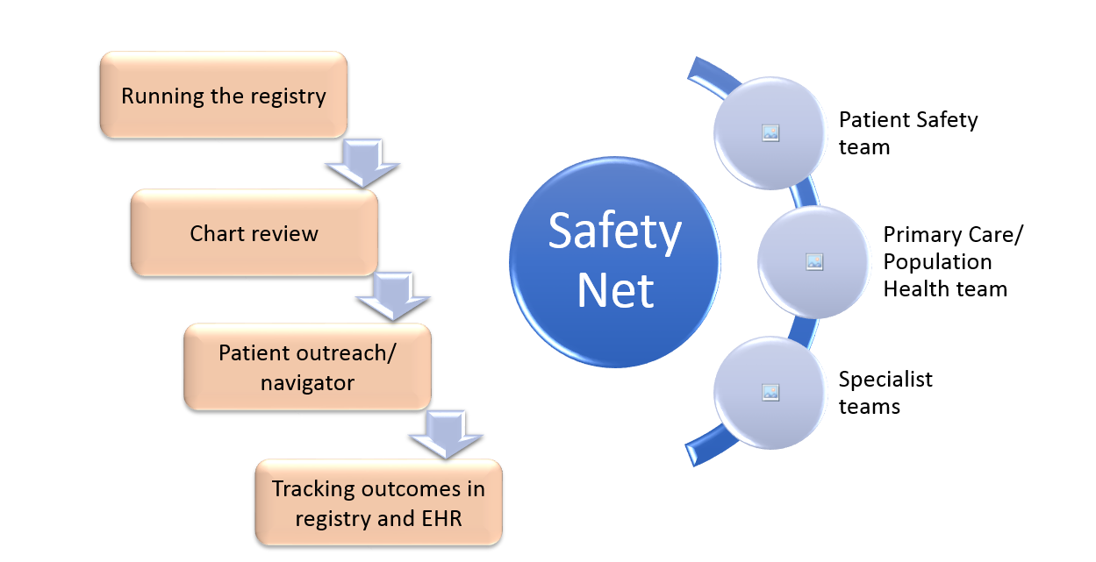
Step 3: Workflow Redesign

Slide 11
Step 4: Patient Outreach and Tracking
What is the right team composition?
Centralized, de-centralized or hybrid process?
Outreach via phone, letter, text or in-person?

Slide 12
Colon Cancer Safety Nets

Slide 13
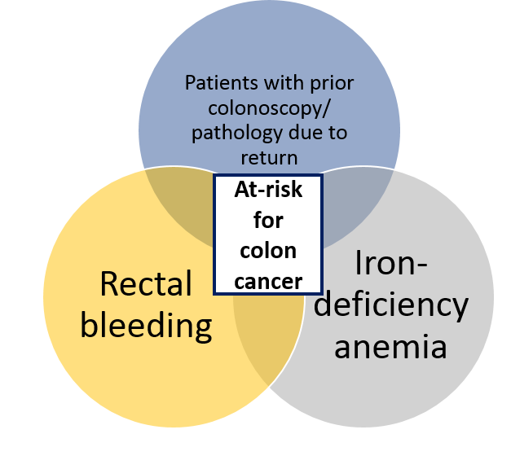
Colon Cancer Safety Nets

Slide 14
GI Recall Registry: Abnormal Colonoscopy (C-scope) + Pathology
C-scope done years ago
How does one identify the patient as being “due” for their next c-scope?
C-scope result
Pathology
Return interval for next c-scope
Patient risk factors
Shared responsibility for the patient’s follow-up care plan between GI and Primary Care by shifting responsibility of updating return interval in EMR

Slide 15
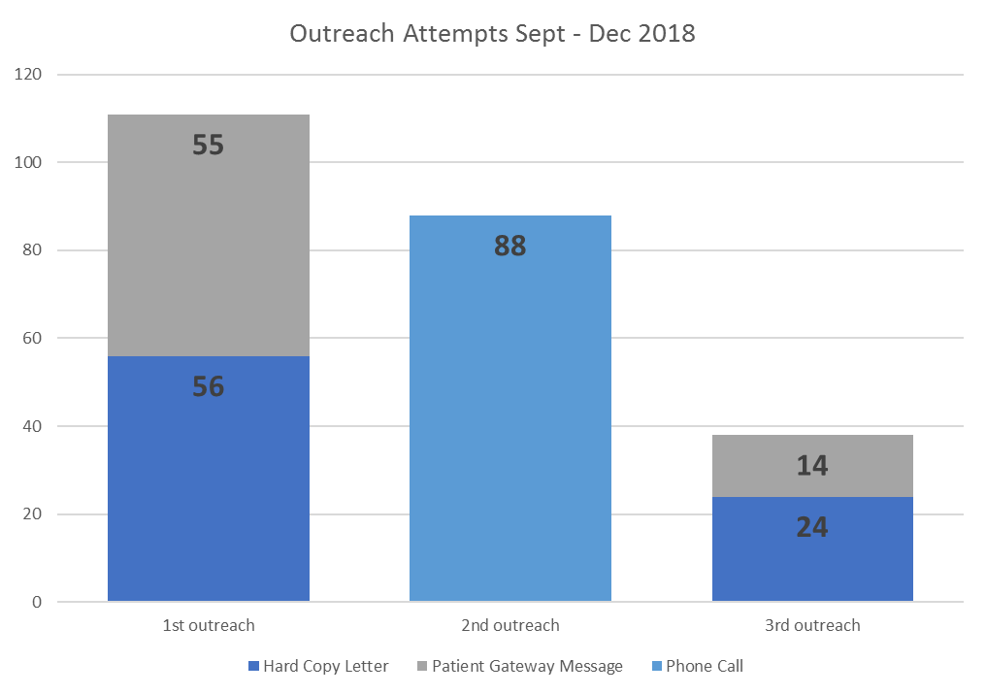
Patient Navigator
Transportation
Do you have someone who can pick you up after the procedure?
We provide transportation and escort services within the Boston-Metro area
Colonoscopy Prep
Would it be helpful if I walked through the prep instructions with you?
Do you need reminder calls during your preparation?
Interpreter
(If necessary) would an interpreter be helpful?
We can send you prep instructions in English or Spanish
Letter – phone call – letter format works the best for outreaching to patients

Slide 16
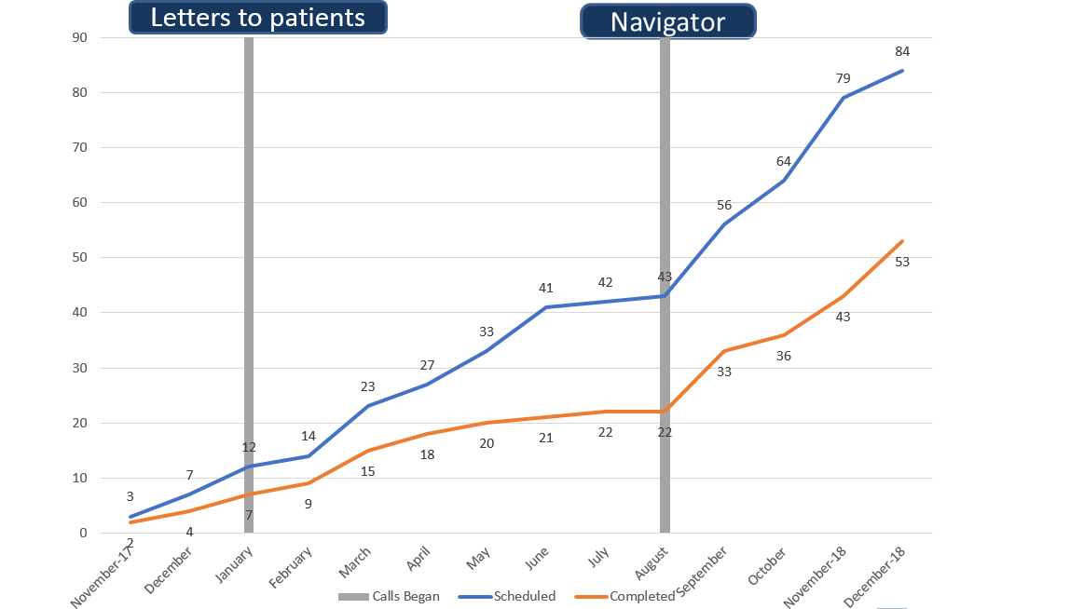

Slide 17
Clinical Vignette
28 year old female with IBD had last colonoscopy in 2015
Identified through Safety Net registry as due for colonoscopy in January 2018
2 letters sent to patient using registry functionality
Patient scheduled for colonoscopy April 2018
Colonoscopy identified high-grade dysplasia
Surgical consultation obtained with recommendation for colectomy to prevent future colon cancer
Even one early detection can demonstrate the immediate impact of Safety Nets on patient care

Slide 18
Rectal Bleeding (RB) and Iron-Deficiency Anemia (IDA) Safety Nets

Slide 19
Rectal Bleeding and Iron-Deficiency Anemia
Pilot program with 4 Primary Care Practices started July 2018
Lesson learned: electronic registries – need to be more specific and actionable to minimize chart review burden (over 3,500 patients identified as at-risk)

Slide 20
Clinical Vignette
PHM did chart review on patient with RB
Noted that patient has Ulcerative Colitis and is followed by BWH GI but c-scope not done, just sigmoidoscopy
PHM coordinated communication b/w GI MD, PCP and GI triage RN – plan made for discussion with patient on importance of c-scope
PHM talked to patient and scheduled c-scope for November 2018
Early findings from RB/ IDA work suggest that even patients with multiple BWH physicians may fall through the cracks without adequate patient outreach, coordination of care, education and navigation

Slide 21
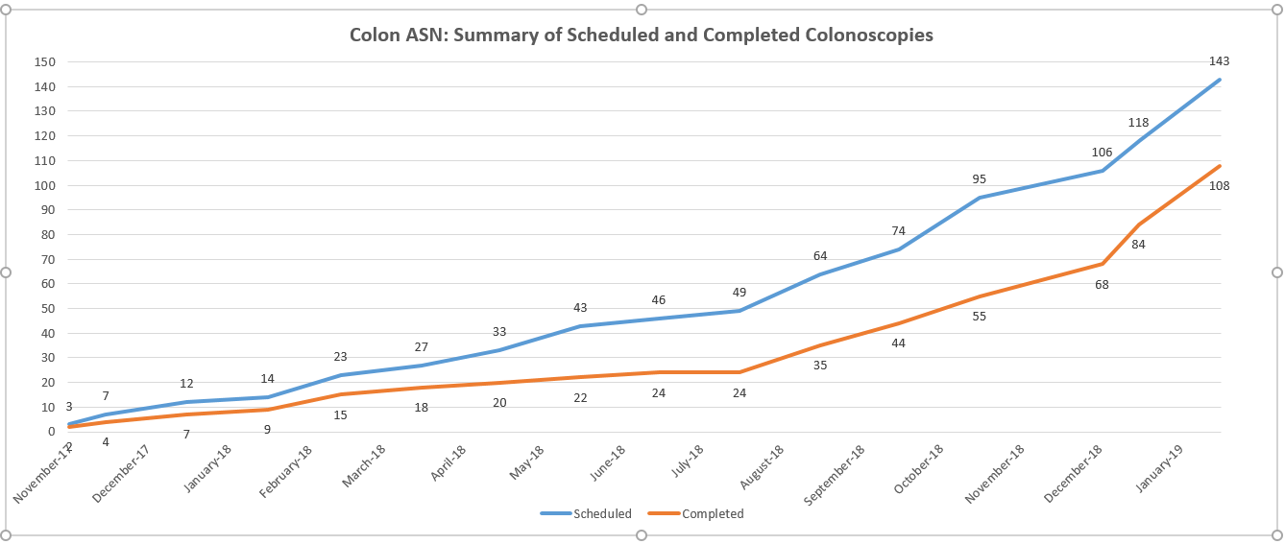
Cumulative Impact of Colon Cancer Safety Net: GI Recall and RB/ IDA work

Slide 22
Lung Cancer Safety Net

Slide 23
Lung Nodule Safety Nets: 2016-2017
Identify
Apply NLP to radiology reports
Narrow scope
Cross reference with BWH PCP, DFCI, Thoracic Surgery
Validate
Chart review to ensure true incidental nodule
Patient outreach and track
Email PCPs with lists and track if f/u completed

Slide 24
Lung Cancer Safety Net: RADAR 2018
Alert & Acknowledge
Develop a Follow-up Plan
Automated
Resolution
Radiology Result
March 2018 – pilot in Primary Care practices
Radiology will send you an alert, suggest specific follow-up, offer to schedule the test and alert you if not completed in recommended timeframe

Slide 25
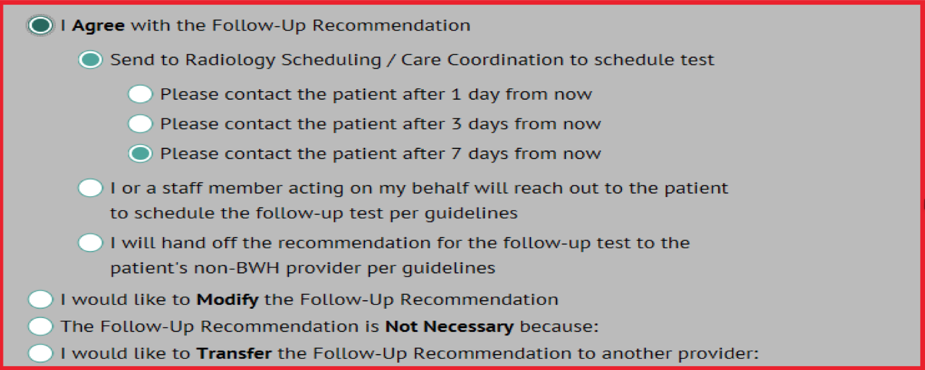
RADAR: What the Ordering Clinician Sees

Slide 26
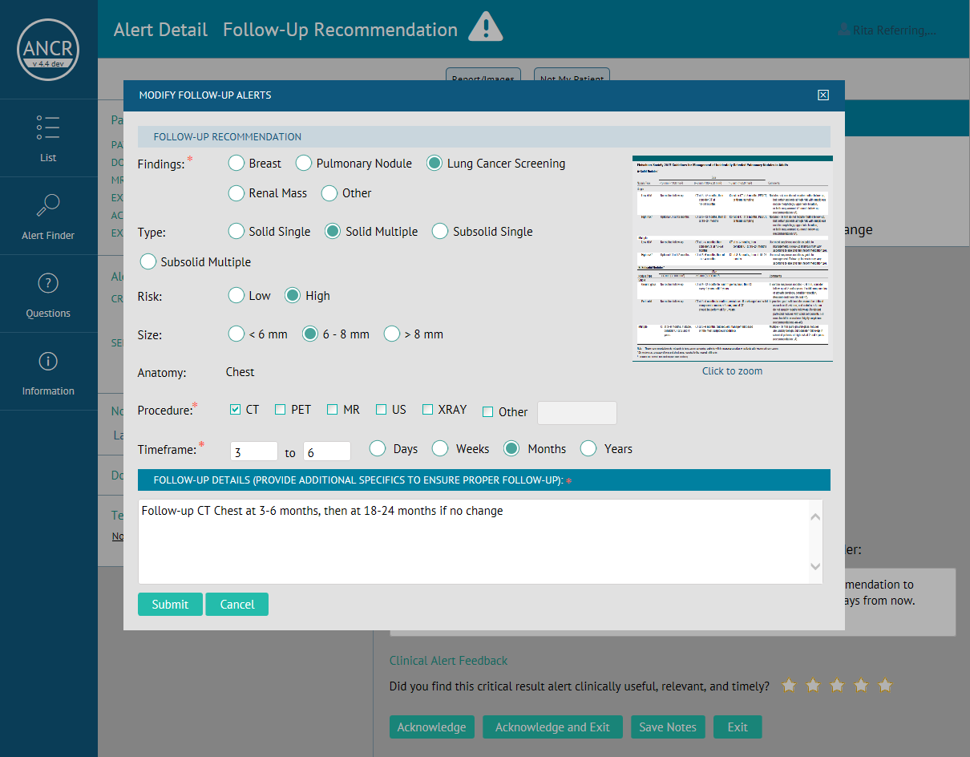

Slide 27
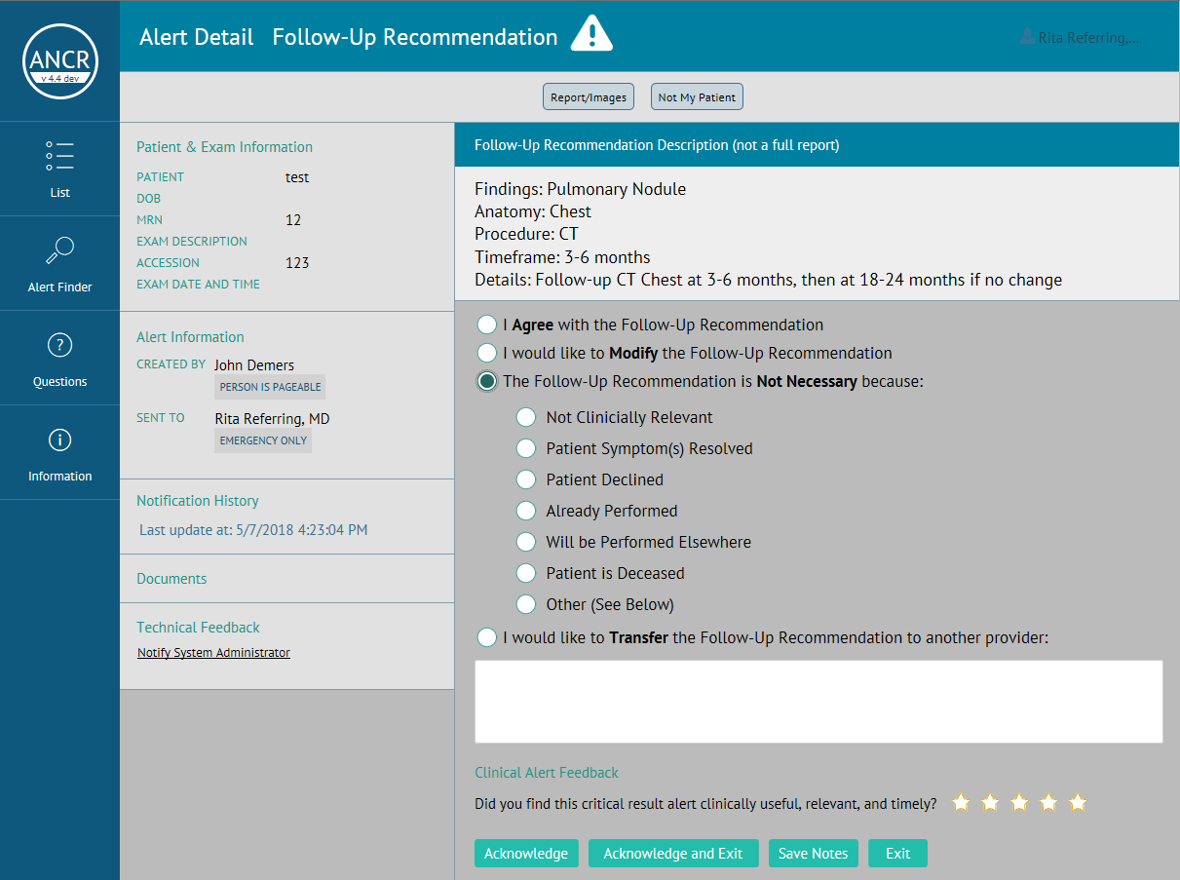
Radiology system with automatically check to see if follow-up chest CT scan is completed in recommended timeframe – if not, it will then send alert to Radiology and PCP (or ordering clinician) – Closed-Loop Follow-Up

Slide 28
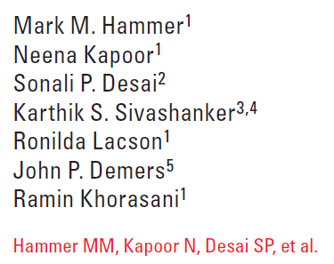
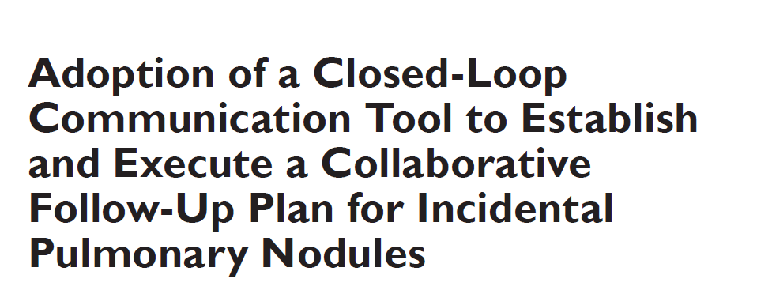
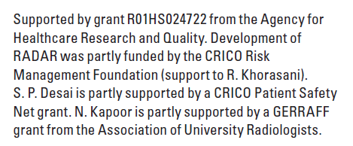
American Journal of Radiology, May 2019 (in-press)

Slide 29
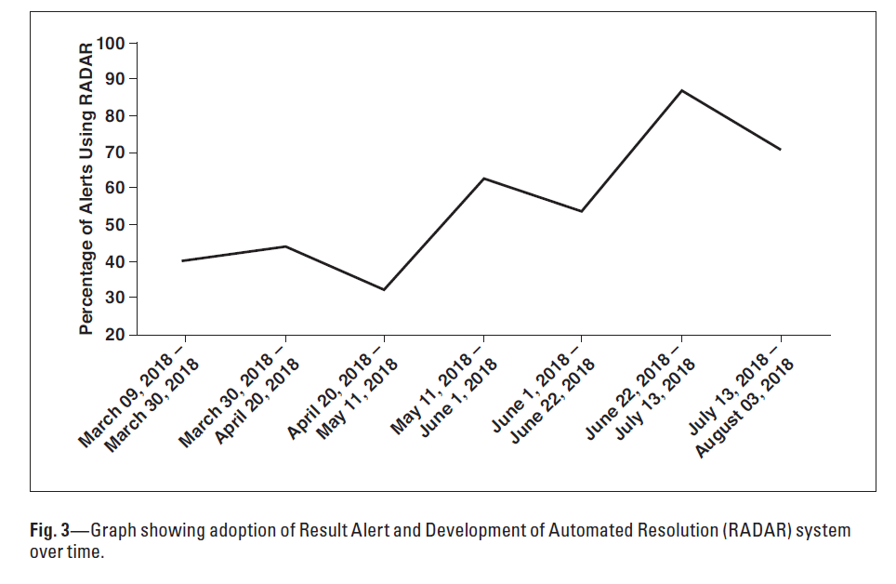
RADAR Adoption: March – August 2018

Slide 30
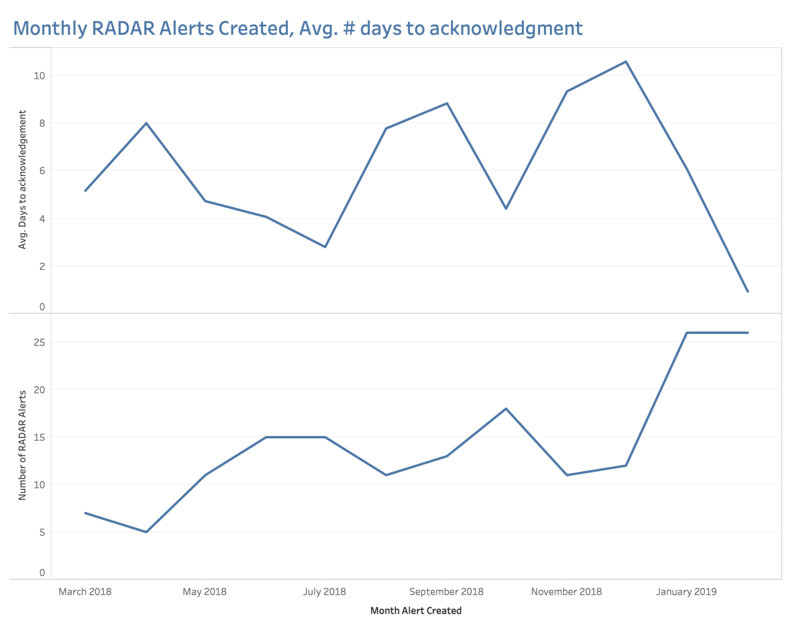

Slide 31
RADAR: Speed and Likelihood of Scheduling
Days
Alert Type
RADAR Alerts are scheduled faster than usual notification alerts
RADAR alerts are more likely to be scheduled than usual alerts – use of Radiology central scheduling
Notes:
Based on manual chart review of Blue->Yellow alerts

Slide 32
Lung Nodule Next Steps
Pri Care
March 2018
Pulmonary Jan 2019
Medicine Specialties
Feb 2019
Inpatient and ED - 2019

Slide 33
Ambulatory Safety Nets:
Beyond Colon and Lung Cancer
Radiology
Breast (BIRADS3)
Pancreatic cysts
Cancer
Prostate
Cervical
Medication Safety
High-risk medications
High-risk patients
Patient Navigator #1
Patient Navigator #2
Project Manager
Medical Director
Pharmacist
New Ambulatory Safety Net team funded through hospital operating budget for 2019 to maintain, scale and develop new Safety Nets

Slide 34
Challenges and Opportunities
Data, Registries, and Reporting
Patient Outreach, Tracking and Communication
Ambulatory Patient Safety as Hospital Priority

Slide 35

Questions?
Sonali Desai: sdesai5@bwh.harvard.edu

